Slide 1
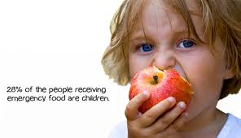
Food Pantries
Gardeners
Find Food
Help Out
About Us
AmpleHarvest
Eliminating food waste, hunger
and malnutrition
. . .

